Slide 1
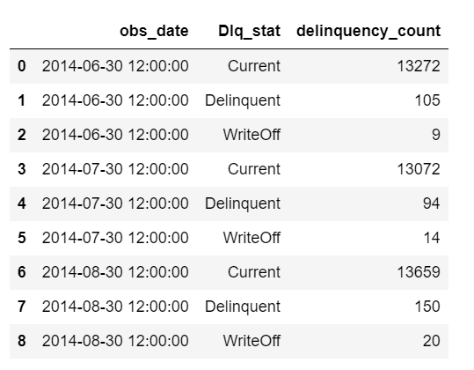
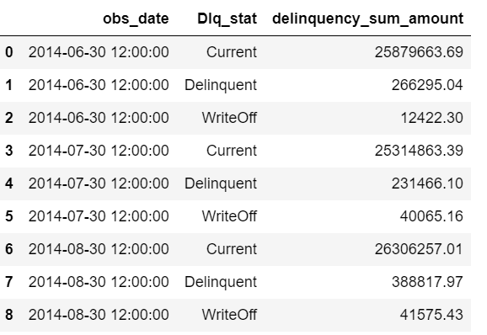
Key trends over the 3 months
Overview:
Total number of loans: 40395
Current, Number: 40003, 99.03%
Delinquent, Number: 349, Percentage: 0.86%
WriteOff, Number: 43, Percentage: 0.11%
1
Total number of Loans drops in July and rises in August.
Total amount of Loans drops in July and rises in August.
2
WriteOff increases along with time as it marked as the LOSS loans.

Slide 2
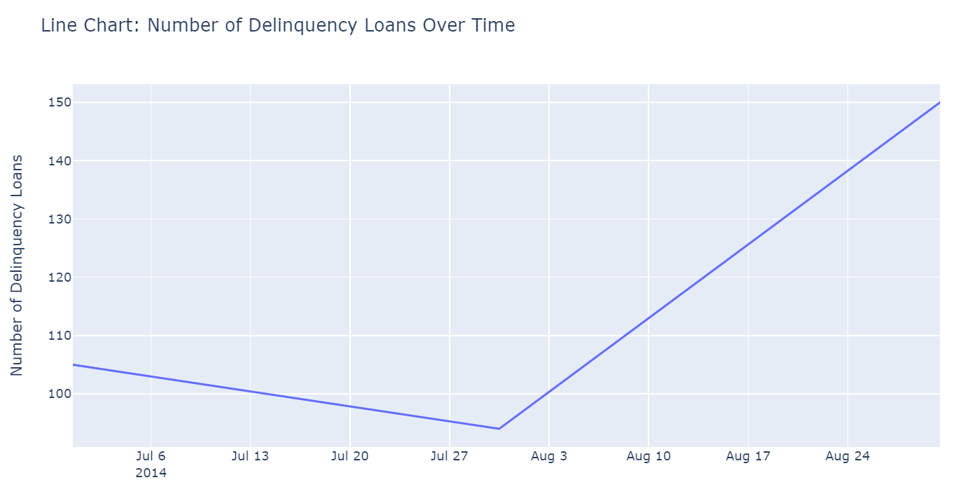
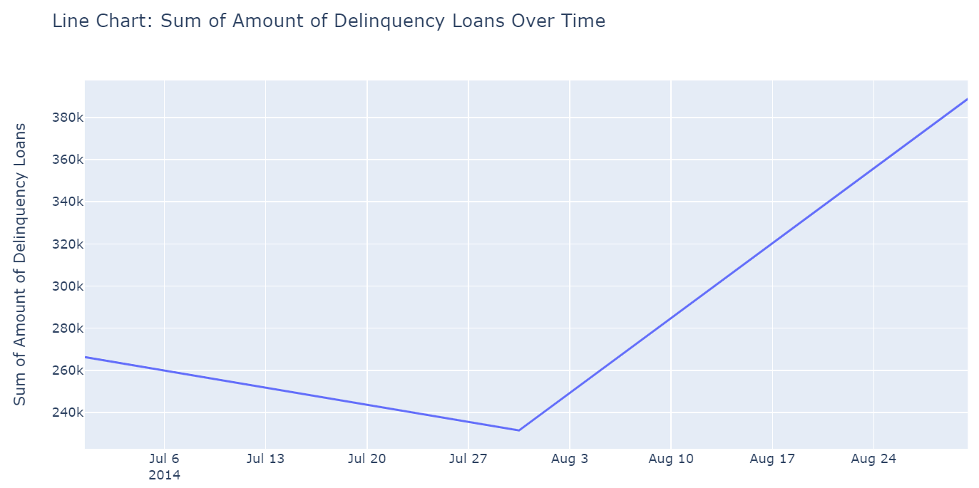
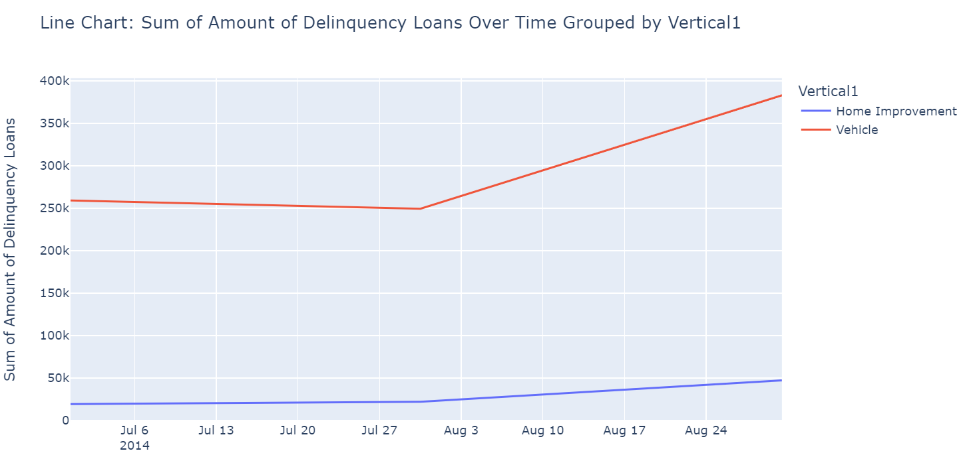
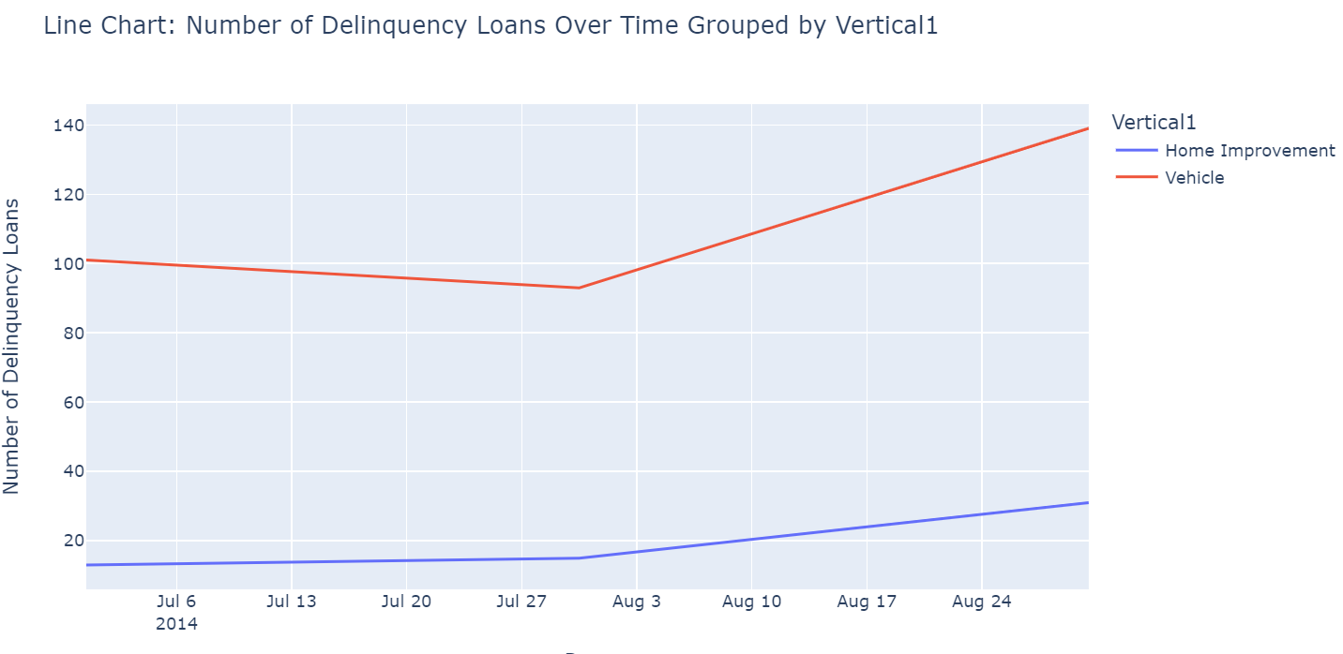
Key trends and insights over the 3 months
The Amount of delinquncy drops a little in July as the total loans drops, Bu increase dramatically in August.
The Amount and number of diferent loan types : Home Improvement and Veicle also drops and rise. But Veicle rise on both metrics more dramatically.
The average amount of delinqucy loan per tranctions are similar among the months. But the delinquency of Home Improvement loan decreses per transaction over the months
3
4
5

Slide 3
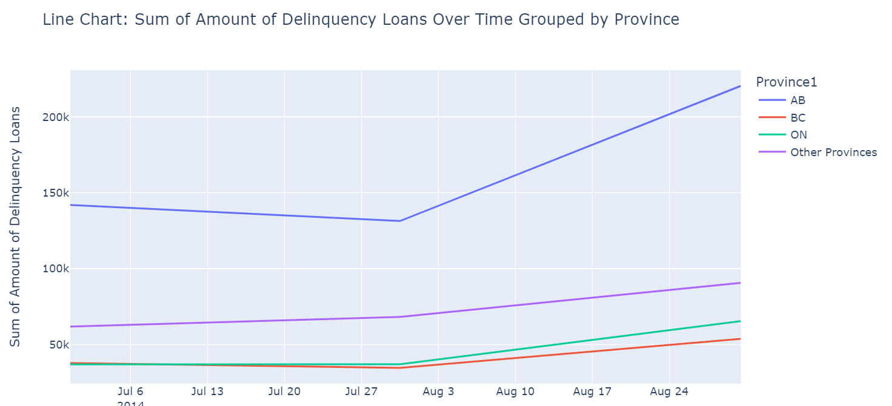
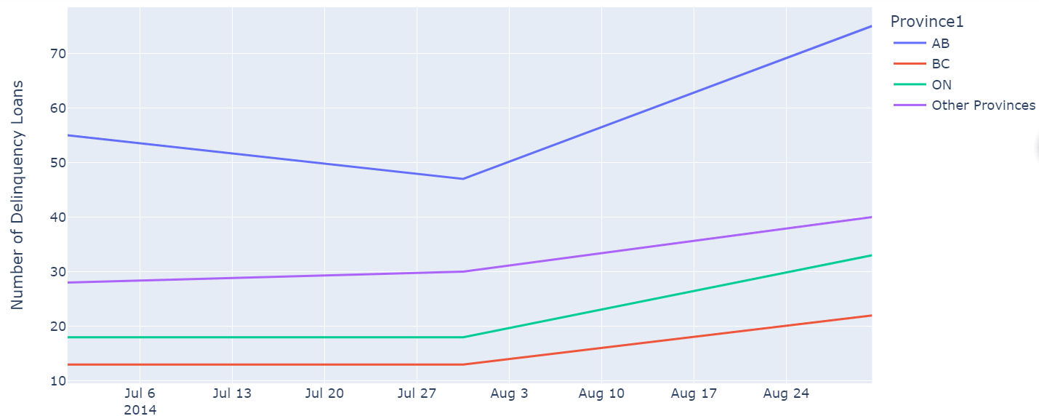
Key trends and insights over the 3 months - Continued
6
Right charts show overall all provices are rise in August
AB province contributes most in the to the loans among all province. ON has less delinquncy amount per transaction than other province.
Other provinces delinquncy loans increases slows for the months then is the BC province
The delinquncy days increases as the time goes by, meaning the old delinqency are still and days extend
7
8
9

